Slide 1
Welcome to
Total Quality Management
(19MEE347)
Unit 3 – ISO 14000
Name: Dr. Sunil Kumar
Department of Mechanical Engineering

Slide 2
ISO 14000 - Introduction
ISO 14000 is concerned with environmental management.
World’s first series of internationally accepted standards of environmental management systems.
Guide to Environmental Management principles, Systems and Supporting techniques.
Voluntary standards that will lead to the common worldwide approach to environmental management system.

Slide 3
Environmental Management System
EMS is a method of going about your business while managing environmental risks.
Provides order and consistency to the organization.
Involves incorporating environmentally responsible practices into everyday business processes.
Recognizes and controls environmental risks while creating measurable improvements in performance.

Slide 4
Why implement EMS?
Improved compliance with environmental laws.
Sustainable development
Credibility
Pressure from environmentalists
Worldwide focus to the enviroment

Slide 5
ISO 14000 standards
Series of international standards for environmental management.
ISO 14001 is the first in the 14000 series and specifies requirements of an EMS.
Overall aim of ISO 14001 and other standards in the 14000 series is to support environmental protection and the prevention of pollution in the harmony with socio-economic needs.
ISO 14001 applies to any organization that wishes to improve and demonstrate environmental performance to others through the presence of a certified EMS.

Slide 6
ISO 14000 certification process
Preliminary assessment
Document review
Initial assessment
Main Assessment
Certification / registration
Surveillance

Slide 7
ISO 14000 standards
ISO 14001 is the EMS standard and it has a companion standard ISO 14004
14010 series of standards are about auditing
14020 is about environmental labeling.
14030 is a standard on environmental performance evaluation
14040 series standards are on environmental life cycle assessment (LCA) and they are the only part of ISO 14000 series that rely on competent engineering and environmental science.

Slide 8
ISO 14000 standards
ISO 14001 is the EMS standard and it has a companion standard ISO 14004
14010 series of standards are about auditing
14020 is about environmental labeling.
14030 is a standard on environmental performance evaluation
14040 series standards are on environmental life cycle assessment (LCA) and athey are the only part of ISO 14000 series that rely on competent engineering and environmental science.

Slide 9
Environmental policies in companies
L&T
Ashok Leyland
Bilt
Toyota Kirloskar
Nippon Toyota

Slide 10
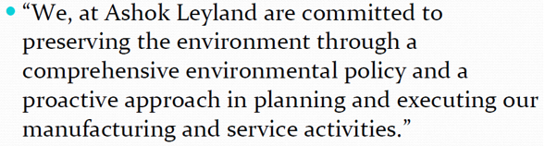
Environmental policies in companies
Ashok Leyland

Slide 11
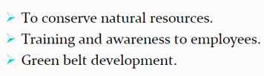
Environmental policies in companies
Toyota Kirloskar

Slide 12
THANK YOU!!!

